Slide 1
Mutual Learning with Consensus Dice Loss for Brain Tumor Segmentation
胡敬玉

Slide 2
目录
研究背景
Mutual Learning
2. 主要工作

Slide 3
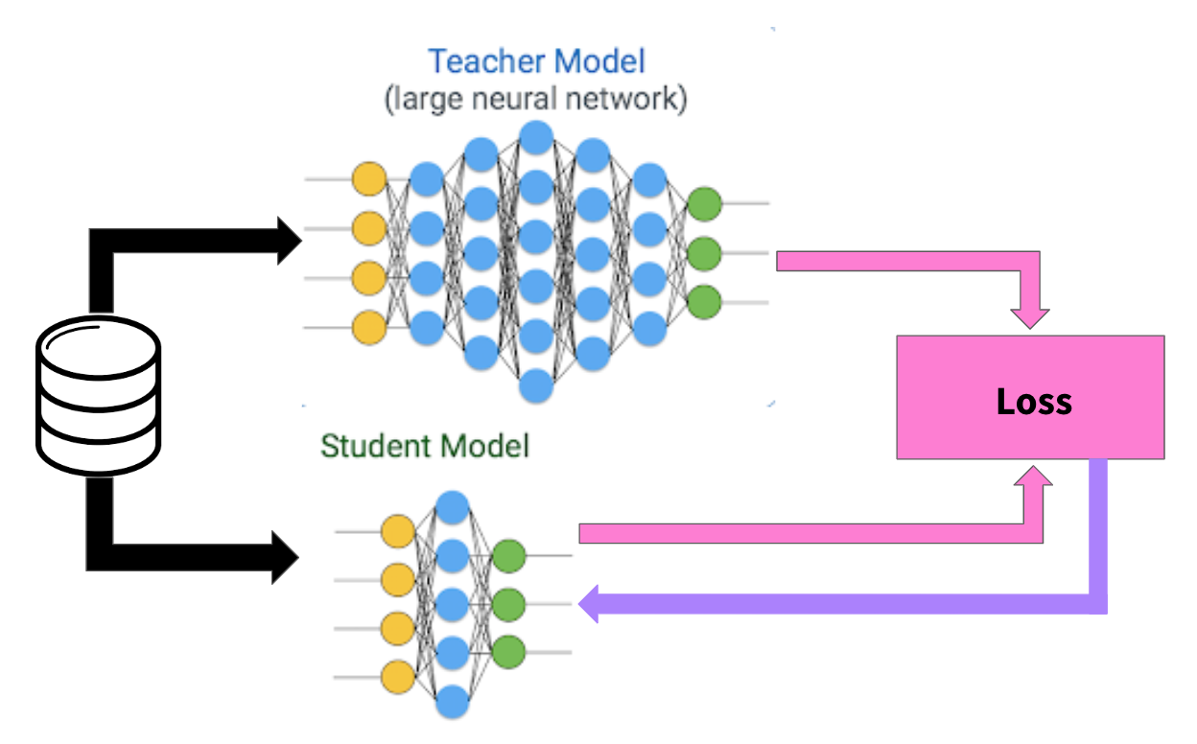
Deep Mutual Learning
模型蒸馏

Slide 4
Deep Mutual Learning
模型蒸馏能够从复杂网络中学习知识，构造一个简单网络，并且保证这个小网络相对于复杂网络的性能没有较大的损失。
占用内存较多
实现速度慢
Deep Mutual Learning
子网络相互地学习
Y. Zhang, T. Xiang, T.M. Hospedales, H. Lu, Deep Mutual Learning, in: 2018 IEEE/CVF Conference on Computer Vision and Pattern Recognition(CVPR), IEEE, Salt Lake City, UT, 2018: pp. 4320–4328.

Slide 5
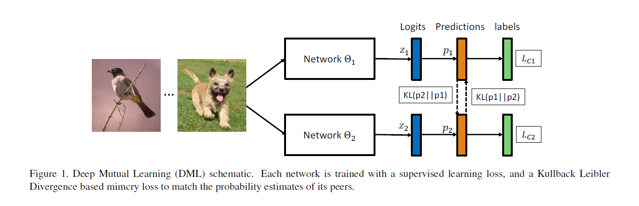
Deep Mutual Learning
Y. Zhang, T. Xiang, T. M. Hospedales, and H. Lu, “Deep Mutual Learning,” in 2018 IEEE/CVF Conference on Computer Vision and Pattern Recognition, Salt Lake City, UT, 2018, pp. 4320–4328.

Slide 6
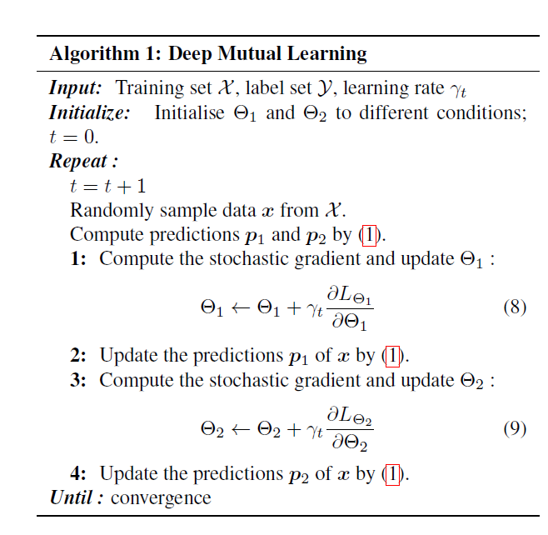
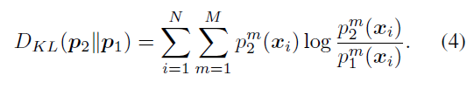
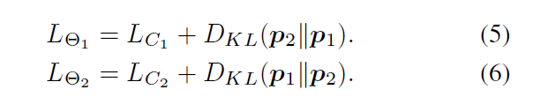
方法

Slide 7
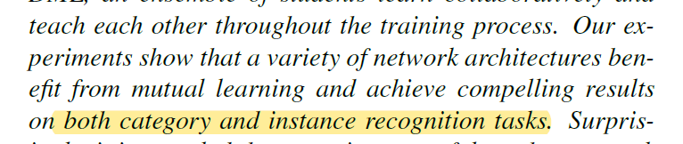
Mutual Learning 在图像分类任务上提升了网络性能，我们希望将其迁移到脑肿瘤分割任务上。
KL散度缺少监督信息，我们增加了监督信息，设计了像素级的Consensus Dice 损失。

Slide 8
目录
研究背景
Mutual Learning
2. 主要工作

Slide 9
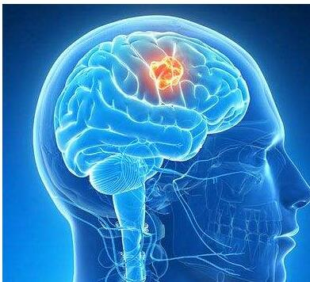
神经胶质瘤
胶质瘤是由神经胶质细胞发展而来，是最常见的成人脑肿瘤。
胶质瘤
高级别胶质瘤(HGG)
生存时间最多两年
低级别胶质瘤(LGG)
生存时间有几年

Slide 10
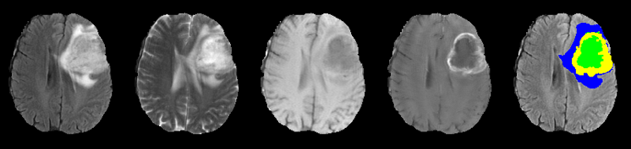
磁共振
FLAIR
T2
T1
T1ce
Manual Segmentation
MRI 的优点
非侵入式的检测方法
没有辐射，不会造成不良影响
手工分割
耗时
繁琐

Slide 11
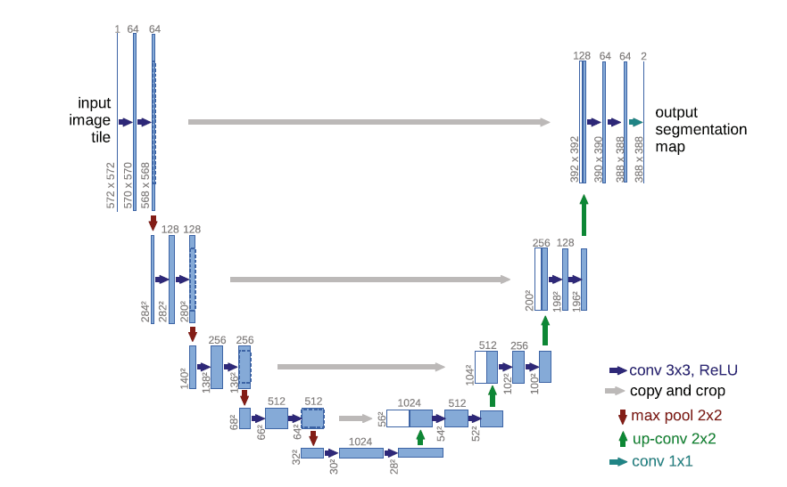
相关工作
DeepMedic
U-Net
K. Kamnitsas, C. Ledig, V. F. J. Newcombe, J. P. Simpson, A. D. Kane, D. K. Menon, D. Rueckert, and B. Glocker, “Efficient multi-scale 3D CNN with fully connected CRF for accurate brain lesion segmentation,” Medical Image Analysis, vol. 36, pp. 61–78, Feb. 2017.
O. Ronneberger, P. Fischer, and T. Brox, “U-Net: Convolutional Networks for Biomedical Image Segmentation,” in Medical Image Computing and Computer-Assisted Intervention – MICCAI 2015, vol. 9351, N. Navab, J. Hornegger, W. M. Wells, and A. F. Frangi, Eds. Cham: Springer International Publishing, 2015, pp. 234–241.

Slide 12
方法

Slide 13
方法
Consensus Dice Loss
Where N is the number of the input voxel, p_{i} and q_{i} are the prediction of top branch and bottom branch, and g_{i} is the voxel of ground truth.

Slide 14
方法
Consensus Dice Loss
The gradient of F with respect to p_{j} :
The gradient of F with respect to q_{j} :

Slide 15
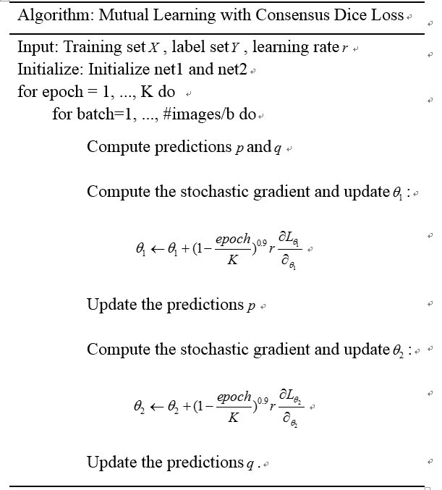
改进算法

Slide 16
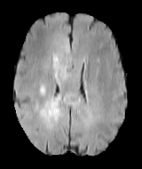
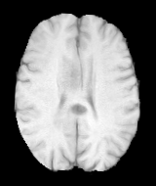
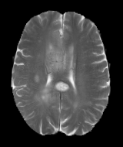
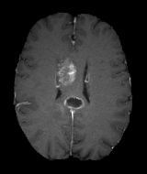
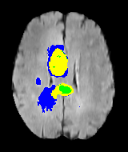
实验
Multimodal Brain Tumor Segmentation Challenge 2018（BRATS 2018）
FLAIR
T1
T1ce
T2
蓝色：囊肿
黄色：增强结构
绿色：坏死部分
Complete Dice
Core Dice
Ground Truth
Enhance Dice

Slide 17
实验
评价指标：

Slide 18
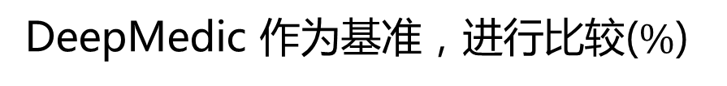
实验
DeepMedic 作为基准，进行比较($\%$)
Network Types |  | BRATS 2018
 |  | Independent |  | ML-KL |  | ML-KL-Ind |  | ML-CD |  | ML-CD-Ind
DeepMedic |  | Net 1 | Net 2 | Net 1 | Net 2 | Net 1 | Net 2 | Net 1 | Net 2 | Net 1 | Net2
Dice | Com. | 85.57 |  | 86.38 | 85.11 | 0.81 | -0.46 | 86.90 | 83.51 | 1.33 | -2.06
 | Core | 75.36 |  | 76.92 | 75.52 | 1.56 | 0.16 | 80.04 | 77.08 | 4.68 | 1.72
 | Enh. | 72.99 |  | 74.78 | 72.76 | 1.79 | -0.23 | 73.75 | 73.25 | 0.76 | 0.26

Slide 19
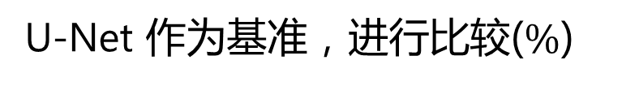
实验
U-Net 作为基准，进行比较($\%$)
Network Types |  | BRATS 2018
 |  | Independent |  | ML-KL |  | ML-KL-Ind |  | ML-CD |  | ML-CD-Ind
U-Net |  | Net 1 | Net 2 | Net 1 | Net 2 | Net 1 | Net 2 | Net 1 | Net 2 | Net 1 | Net2
Dice | Com. | 87.13 |  | 86.71 | 87.19 | -0.42 | 0.06 | 89.26 | 87.63 | 2.13 | 0.50
 | Core | 79.25 |  | 78.55 | 79.08 | -0.7 | -0.17 | 82.89 | 82.01 | 3.64 | 2.76
 | Enh. | 74.47 |  | 73.38 | 72.52 | -1.09 | -2.22 | 75.80 | 73.25 | 1.33 | -1.22

Slide 20
实验
比较网络1采用 DeepMedic，网络2采用 U-Net ($\%$)
Network Types |  | BRATS 2018
 |  | Independent |  | ML-KL |  | ML-KL-Ind |  | ML-CD |  | ML-CD-Ind
 |  | Net 1 | Net 2 | Net 1 | Net 2 | Net 1 | Net 2 | Net 1 | Net 2 | Net 1 | Net2
 |  | DeepMedic | U-Net | DeepMedic | U-Net | DeepMedic | U-Net | DeepMedic | U-Net | DeepMedic | U-Net
Dice | Com. | 85.57 | 87.13 | 87.85 | 87.27 | 2.28 | 0.14 | 87.71 | 88.20 | 2.14 | 1.07
 | Core | 75.36 | 79.25 | 78.42 | 77.88 | 3.06 | -1.37 | 80.74 | 81.75 | 5.38 | 2.5
 | Enh. | 72.99 | 74.47 | 74.00 | 68.41 | 1.01 | -6.06 | 75.22 | 74.54 | 2.23 | 1.07

Slide 21
为了解决存在的某个网络因为相互学习变差的情况，我们采用模型集成的方法来获得更加鲁棒的结果。

Slide 22
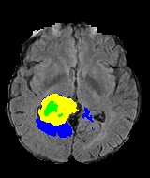
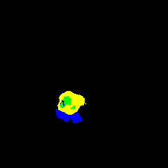





实验
定性比较
Ground Truth
DeepMedic
U-Net & U-Net with KL
U-Net & U-Net with CD
U-Net
DeepMedic & U-Net with KL
DeepMedic & U-Net with CD

Slide 23


实验
Ground Truth
U-Net & U-Net with CD

Slide 24

实验
比较集成网络1和网络2($\%$)
Network Types |  | BRATS 2018
 |  | Independent |  | ML-CD |  |  | ML-CD |  |  | ML-CD
 |  | Net 1 | Net 2 | Net 1 | Net 2 | Ensemble | Net 1 | Net 2 | Ensemble | Net 1 | Net 2 | Ensemble
 |  | U-Net | DeepMedic | DeepMedic | DeepMedic |  | U-Net | U-Net |  | DeeMedic | U-Net
Dice | Com. | 87.13 | 85.57 | 86.90 | 83.51 | 86.56 | 89.26 | 87.63 | 88.87 | 87.71 | 88.20 | 88.67
 | Core | 79.25 | 75.36 | 80.04 | 77.08 | 80.47 | 82.89 | 82.01 | 82.97 | 80.74 | 81.75 | 82.42
 | Enh. | 74.47 | 72.99 | 73.75 | 73.25 | 74.28 | 75.80 | 73.25 | 75.80 | 75.22 | 74.54 | 75.54

Slide 25
总结
Mutual Learning算法可以提高U-Net 和 DeepMedic 两个基准模型在脑肿瘤分割的性能，能够有效减少FN
本文提出的 Consensus Dice 损失，比起 KL 散度更适应脑肿瘤分割问题，因为是体素级的制约条件，同时增加了监督信息
集成两个子网络可以进一步提高分割性能，更鲁棒

Slide 26
贡献
将Mutual Learning 算法应用在了脑肿瘤分割问题上
为了适应脑肿瘤分割问题，提出 Consensus Dice 损失函数
为了进一步提高分割性能，将两个子网络进行集成

Slide 27
Thank You!

